Slide 1
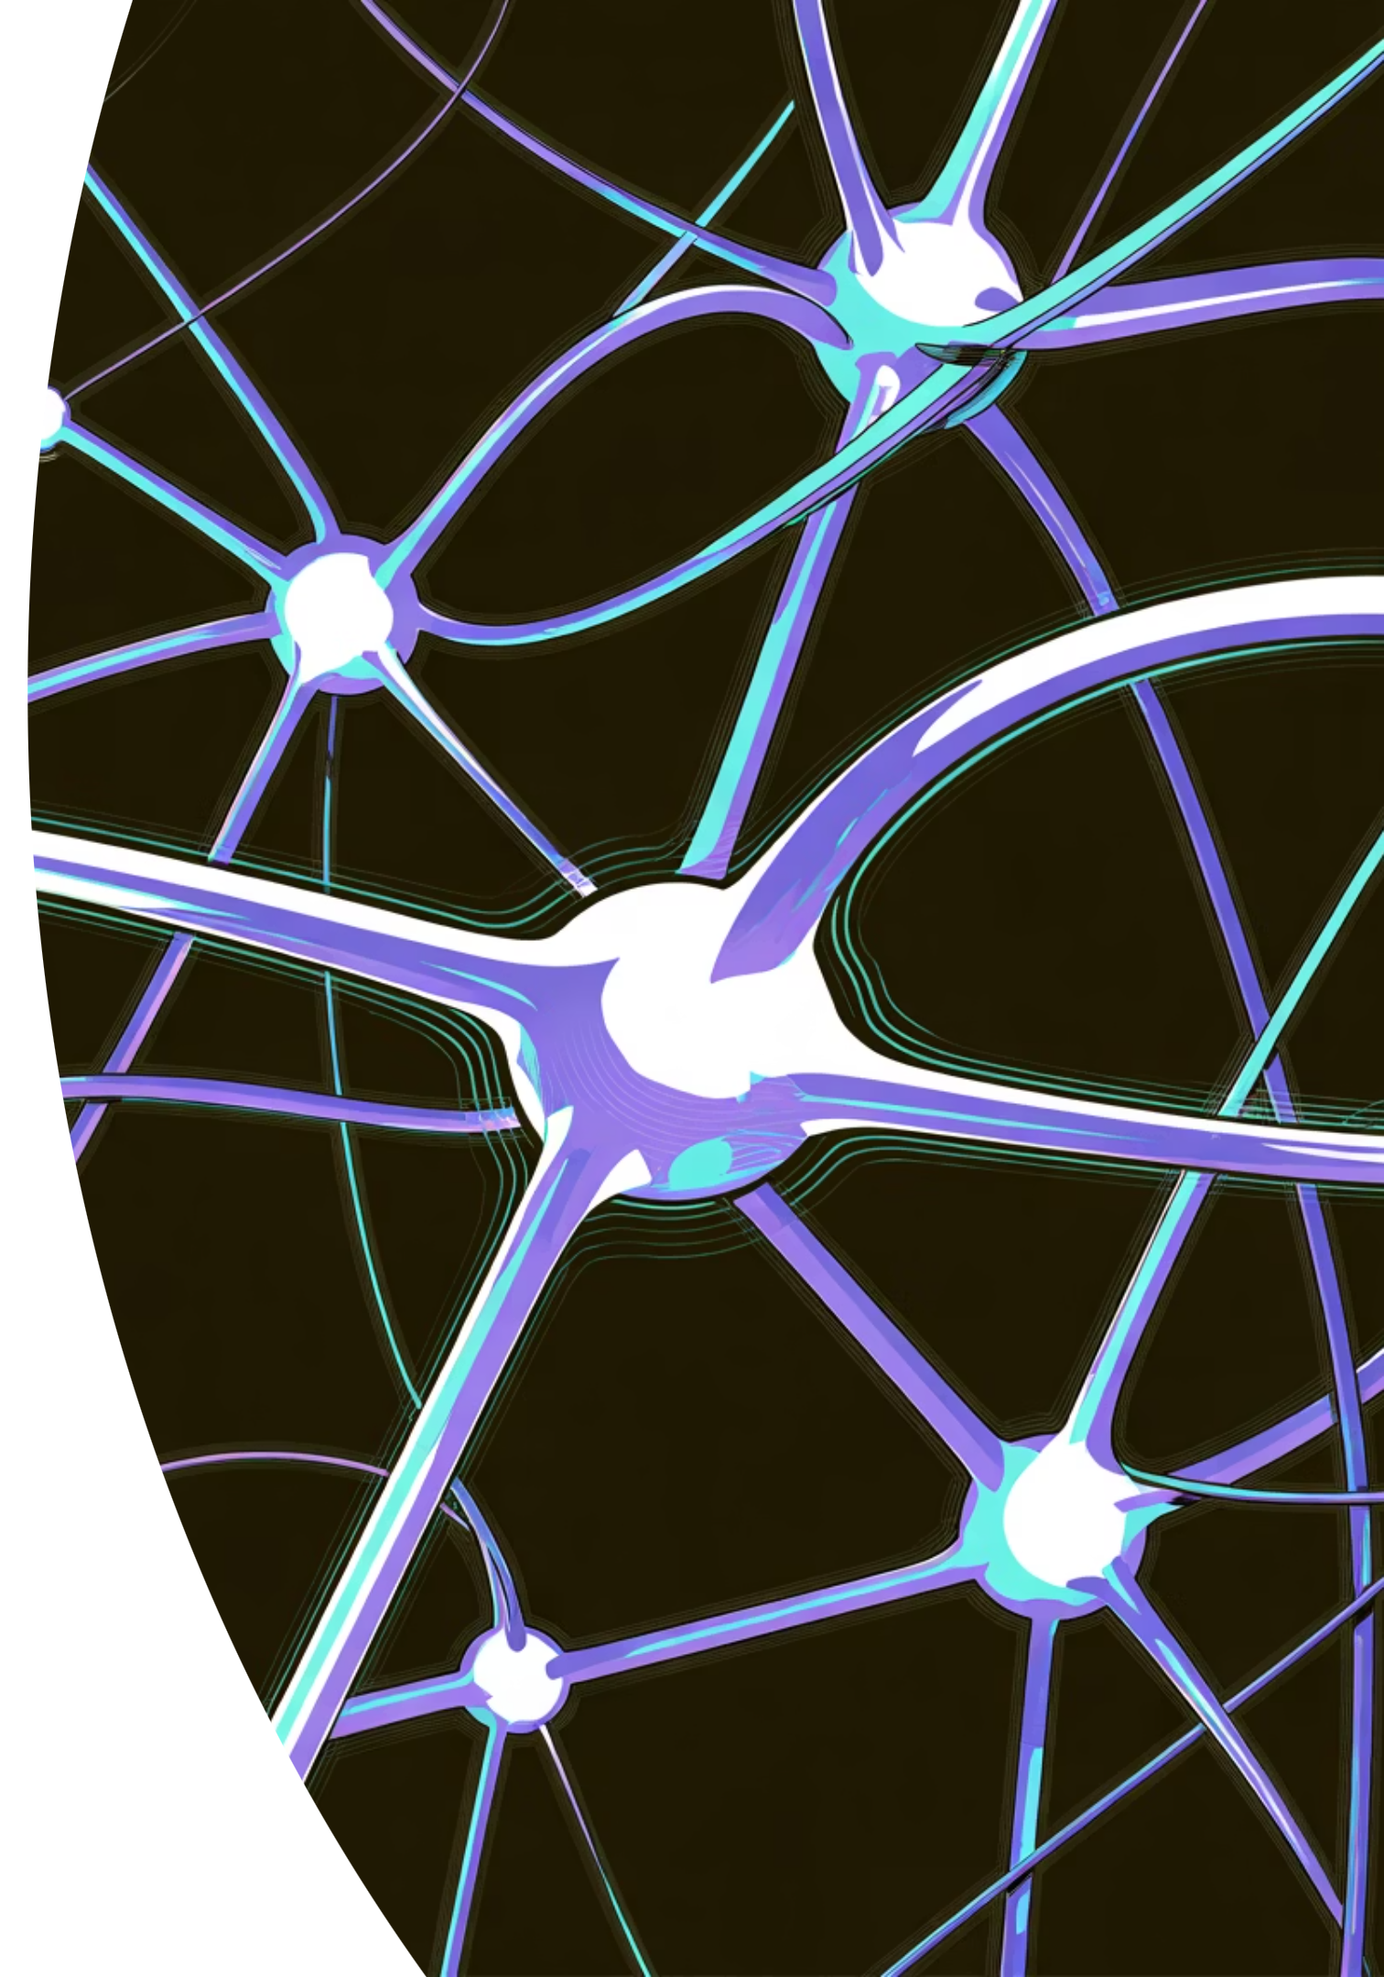
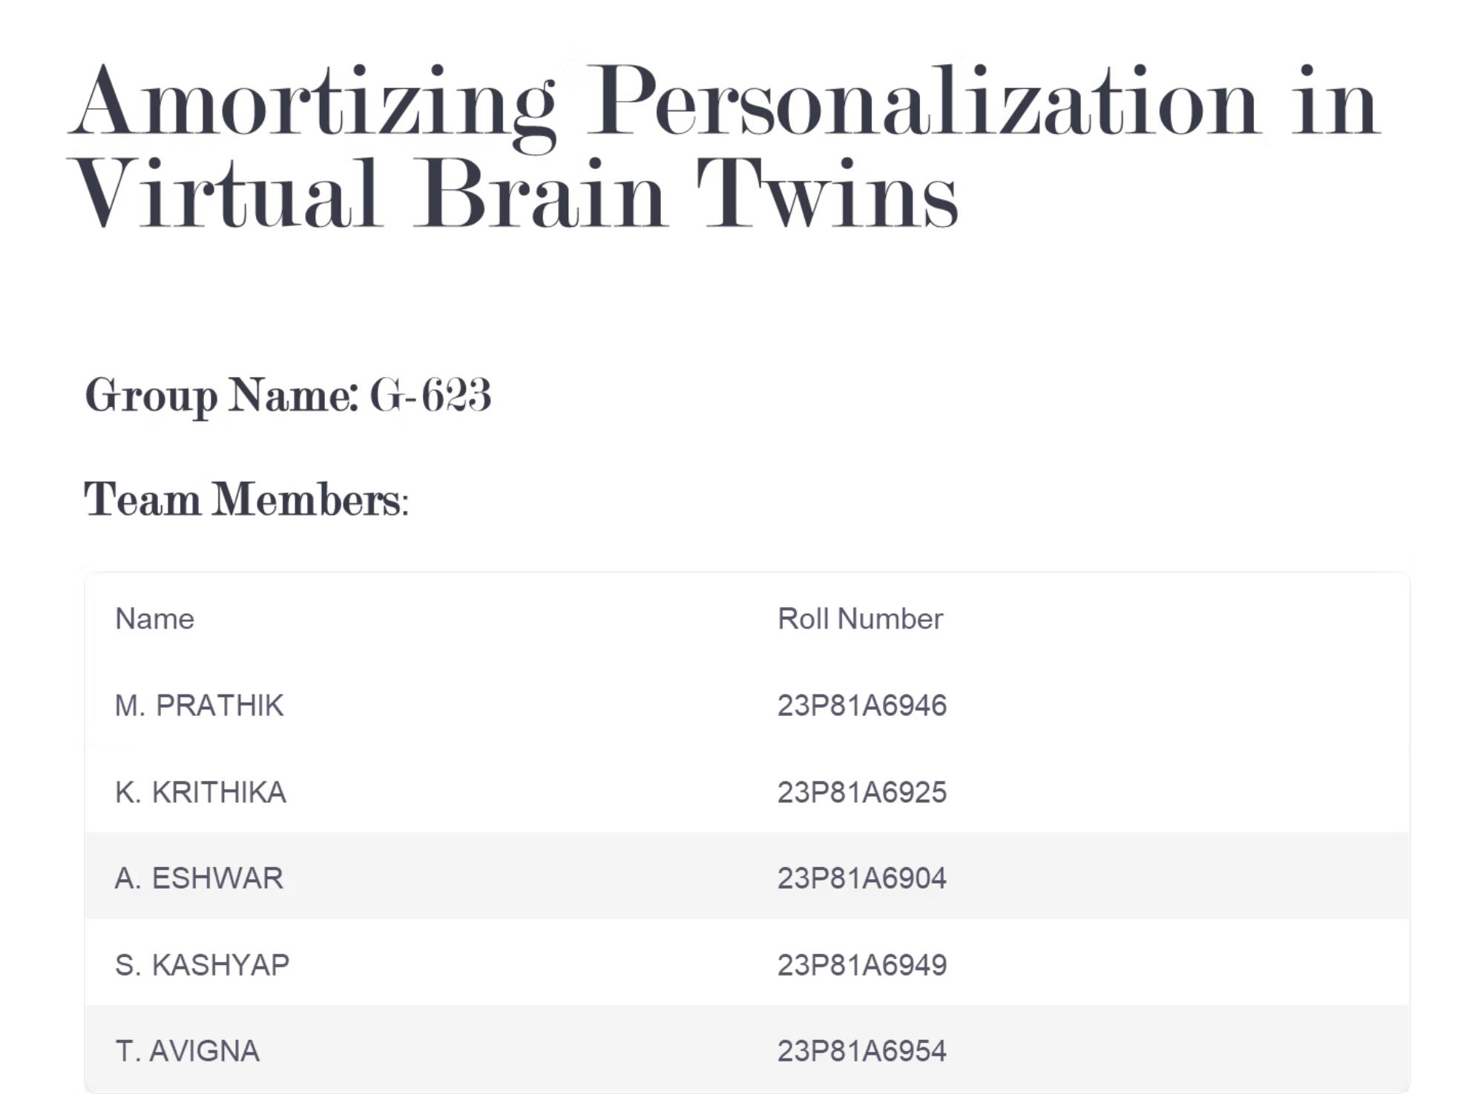
Mentor: K. Navatha

Slide 2
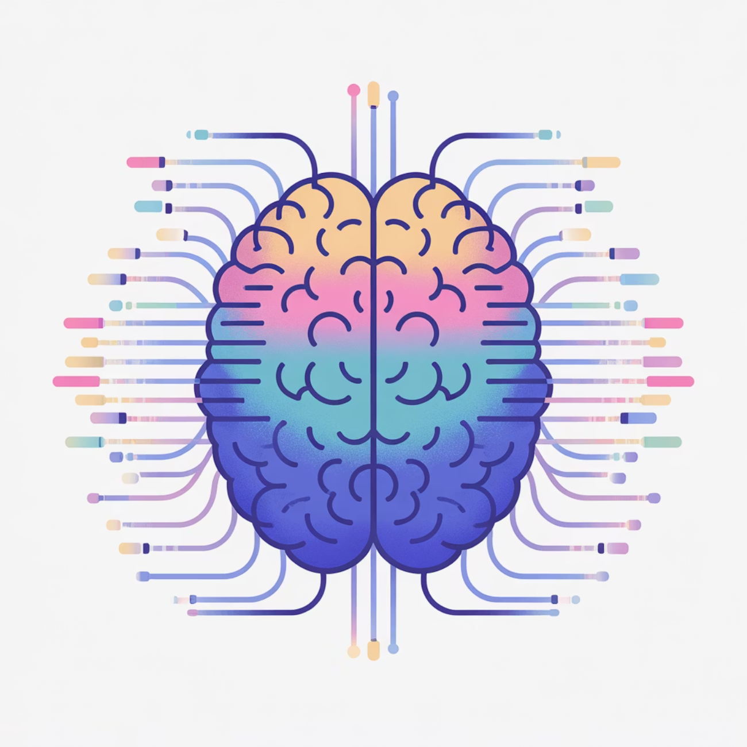
Bridging the Gap in Neural Simulation
The Challenge
Traditional neural simulations generate complex, high-dimensional numerical outputs that are both computationally intensive and difficult to interpret.These cryptic data streams, while rich in mathematical detail, fail to communicate meaningful insights about brain states and cognitive processes to researchers or clinicians.
Our Solution
BIS (Virtual Brain Interpretation System) converts complex neural simulations into clear, human-readable insights using AI-driven natural language generation.
Through amortized personalization, it delivers efficient, privacy-preserving, and scalable neuro-simulation, bridging the gap between computational brain dynamics and human understanding.

Slide 3
System Architecture Overview
01
02
Connectome Input
CrossCoder Harmonization
Multi-atlas brain connectivity data (86–463 nodes)
Unified 16D latent representation
03
04
NeuroCore Simulation
Feature Extraction
Neural mass model execution
Mean firing rate calculation
05
06
State Detection
NLP Interpretation
Activity level classification
Human-readable output generation

Slide 4


Core Technical Components
CrossCoder Harmonization
Converts diverse connectome formats into a unified 16-dimensional latent space, then decodes to canonical 463-node structure for consistent downstream processing.
NeuroCore Simulation Engine
Implements the Montbrió–Pazó–Roxin Neural Mass Model to simulate realistic membrane potentials and firing rates across all network nodes.
FLAN-T5 Language Generation
Transforms quantitative neural states into coherent English descriptions, making results accessible to non-specialists and clinical practitioners.

Slide 5

Technology Stack
Full-Stack Architecture
Development
ML Development: Jupyter notebooks, PyTorch framework, Vs code
API Testing: Postman for endpoint validation
Version Control: GitHub collaborative workflow
Frontend Layer
React.js responsive multilingual interface
Backend Services
Node.js + Express API, FastAPI ML microservices
AI/ML Pipeline
PyTorch, Transformers, Scikit-learn, NLP
Data Storage
MongoDB metadata, Firebase auth & sync

Slide 6

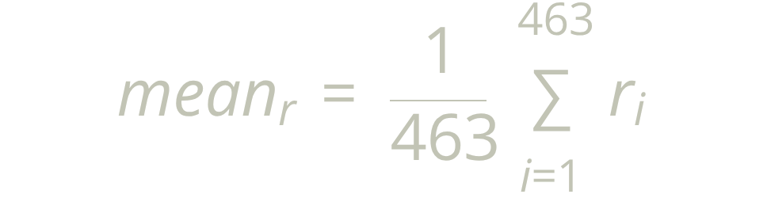

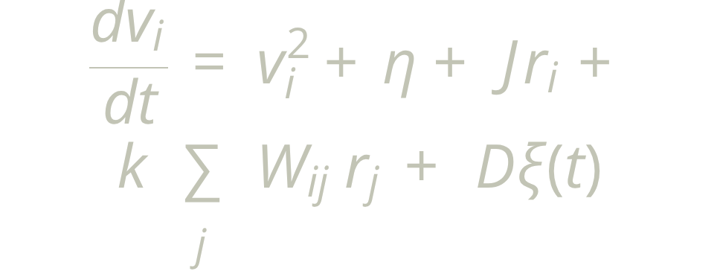
Mathematical Foundation
CrossCoder Latent Encoding
Neural Mass Dynamics
State Classification Logic
where z \in \mathbb{R}^{16} harmonizes connectome structure
Low: mean_r < 0.2 | Normal: 0.2 ≤ mean_r ≤ 0.5 | Hyperactive: mean_r > 0.5
The Montbrió–Pazó–Roxin model parameters include coupling strength (k), noise intensity (D), structural connectivity matrix (Wij), and intrinsic neuron properties (η, Δ, J).

Slide 7
Results & Our Improvements
Performance Metrics
Applications & Impact
1.9
6.3s
Research Acceleration
Rapid hypothesis testing in neuroscience studies
Confusion Rate
Processing Time
CrossCoder
Per connectome average
Drug Response Simulation
Predictive modeling for pharmaceutical development
Key Innovations
Clinical Decision Support
Integration of FLAN-T5 for domain-specific interpretability
Interpretable insights for diagnostic workflows
Three State Classification of Brain
Hybrid MERN + FastAPI modular architecture
End-to-end pipeline from raw data to natural language

